Slide 1
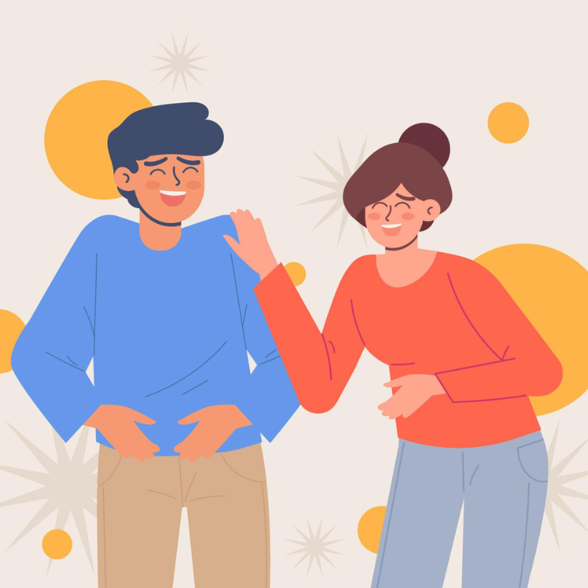
You think this is a joke?
Notes:
To get an editable version of this presentation:
1. Click File > Make a copy > Entire presentation
OR
2. Click File > Download > Microsoft Powerpoint

Slide 2
Let’s get started
with a warm-up
ESL Brains

Slide 3
What is the difference between the things in the boxes?
prank
dad joke
pun

Slide 4
Let’s check the answers.
prank
dad joke
pun
A prank is a playful and often mischievous trick or practical joke played on someone.
A dad joke is a type of joke that is usually corny or cheesy in nature and often relies on puns or wordplay.
A pun is a humorous play on words that exploits multiple meanings or similar-sounding words.

Slide 5
Match the things in the boxes to the examples of the jokes below.
prank
dad joke
pun
How do you organize a space party? You planet.
Let’s switch the numbers in his phone!
I told my wife she was drawing her eyebrows too high. She looked surprised.
I don’t trust stairs because they’re always up to something.
I’m going to put a small piece of clear tape over the sensor on the bottom of her computer mouse. The mouse will still move around, but the cursor won't move on the screen.
A: ‘I'm really cold.' B: 'Go stand in the corner. It's 90 degrees!’

Slide 6
Let’s check the answers.
prank
dad joke
pun
How do you organize a space party? You planet.
Let’s switch the numbers in his phone!
I told my wife she was drawing her eyebrows too high. She looked surprised.
I don’t trust stairs because they’re always up to something.
I’m going to put a small piece of clear tape over the sensor on the bottom of her computer mouse. The mouse will still move around, but the cursor won't move on the screen.
A: ‘I'm really cold.' B: 'Go stand in the corner. It's 90 degrees!’
pun
dad joke
prank
dad joke
pun
prank
dad joke

Slide 7
Let’s talk!
ESL Brains

Slide 8
part 1/2
Discuss the questions.
Which of the things below do you think are funny?
How do you organize a space party? You planet.
Let’s switch the numbers in his phone!
I told my wife she was drawing her eyebrows too high. She looked surprised.
I don’t trust stairs because they’re always up to something.
I’m going to put a small piece of clear tape over the sensor on the bottom of her computer mouse. The mouse will still move around, but the cursor won't move on the screen.
A: ‘I'm really cold.' B: 'Go stand in the corner. It's 90 degrees!’

Slide 9
part 2/2
Discuss the questions.
What is a foolproof way to make you laugh?
Can you give an example of a show that you find hilarious? What makes it funny?
Who do you consider to be witty? How important is it to be quick-witted to have a good sense of humour?

Slide 10
In a moment, you’ll listen to a story titled:
My Little Bruce Dupe

Slide 11
Listen to the story (click the icon) and complete the sentences.
The story is/isn’t amusing because…
The comedian crossed the line/didn’t do anything wrong when… because…
The comedian was being quick-witted/inconsiderate…
The people who own a business in NYC should have appreciated/obviously couldn’t appreciate the prank…
If I had been in their shoes, I would have…
It is appropriate/inappropriate to pull a prank on someone you don’t know because…
Notes:
The story starts where needed, but you should stop it at 41:07 or after 7 minutes.

Slide 12
Let’s discuss!
ESL Brains

Slide 13
Discuss the questions.
Have you ever pulled a prank on someone? Have you been at the receiving end of one?
Do you think pranks are only for gullible people? Why/Why not?
Do you think that social media and the internet have made it easier or harder to pull off successful pranks and jokes? If yes, how?
How do different cultures around the world approach pranks and jokes, and are there any cultural differences in how April Fool's Day is celebrated?
What is your opinion on businesses and companies using April Fool's Day as a marketing opportunity? Can you think of some specific examples? Do you find it entertaining or annoying?

Slide 14
It’s reading time!
ESL Brains

Slide 15
Read about Google pranks and answer the questions.
Google is famous for its elaborate April Fool's Day pranks, which it calls ‘Google Hoaxes’ or ‘Google's April Fool's Day jokes.’ Each year, Google's teams come up with innovative and often hilarious ideas for pranks, which they release on April 1st.
These pranks usually involve introducing new and outlandish products or services that are completely fake or unrealistic. They often include a lot of wit, wordplay and puns, and are meant to be humorous and entertaining. Some of the most memorable Google pranks from past years include Google Nose, Google Tulip, and Parachutes by Google Express.
Have you heard about or seen these pranks before?
What do you think the examples mentioned in the text are about?
Google Nose
Google Tulip
Parachutes by Google Express
Why does Google invest in producing these pranks? How does it pay off?
Notes:
Google Nose – a fake search engine feature that claimed to allow users to search for smells through their computer or mobile device
Google Tulip – a fake service that allowed users to communicate with tulip flowers using the Google Home or Google Assistant app
Parachutes by Google Express – a fake service that delivers things to customers via parachutes
You can ask students to work in three pairs/groups. Share a video about a prank and ask them to watch it. After that, they can retell the prank to the rest of the class and discuss if they think it was funny.
Google Nose https://youtu.be/VFbYadm_mrw
Google Tulip https://youtu.be/nsPQvZm_rgM
Parachutes by Google Express https://youtu.be/F0F6SnbqUcE

Slide 16
Let’s think!
ESL Brains

Slide 17
part 1/4
Look at the opinions below and decide which of the two you agree with more. Explain why.
Humour is an essential element in marketing.
Using humour is a risky marketing strategy.
OR

Slide 18
part 2/4
Look at the opinions below and decide which of the two you agree with more. Explain why.
Humour can be considered offensive.
A joke is just a joke and it shouldn’t be taken seriously.
OR

Slide 19
part 3/4
Look at the opinions below and decide which of the two you agree with more. Explain why.
Dark comedy is never appropriate.
Given the right context, dark humour has comic value.
OR

Slide 20
part 4/4
Look at the opinions below and decide which of the two you agree with more. Explain why.
Humour can diffuse a tense situation.
Humour might lead to a conflict.
OR

Slide 21
Let’s make some jokes!
ESL Brains

Slide 22
Look at the beginnings of some jokes and think of a punch line for each of them.
I wasn’t originally going to get a brain transplant, but…
Why are ghosts bad liars?...
To whoever stole my copy of Microsoft Office, I will find you. You have…
I bought a boat because…

Slide 23
Let’s see some possible answers.
I wasn’t originally going to get a brain transplant, but…
Why are ghosts bad liars?...
To whoever stole my copy of Microsoft Office, I will find you. You have…
I bought a boat because…
then I changed my mind.
You can see right through them.
my Word!
it was for sail.
Notes:
Ask students if they think the jokes from the possible answers are funny. Ask them what they think is more important: the joke itself or its delivery. Discuss what other things are important in comedy.
Possible answers:
context
unexpected punch line
facial expression, gestures
the ability to read the audience
tone of voice/intonation
awareness of current events
If your students are in a good mood and/or there’s time left, you can try a ‘Don’t laugh’ challenge on the next slide.

Slide 24
Read the question to your partner, wait for the partner to ask ‘What?’ or ‘Why?’ and then reveal the punch line. If your partner laughs, you get a point. If the partner doesn’t laugh, they get a point.
Student A
Student B

Slide 25
THANKS!
ESL Brains

