Slide 1
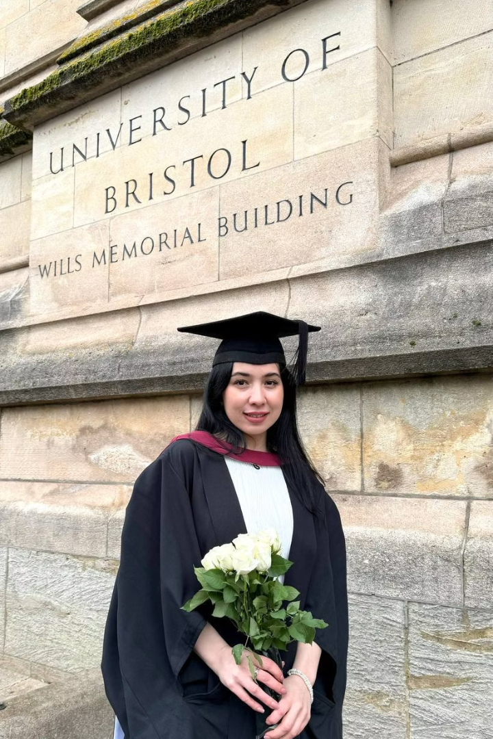
Born Anywhere, Become Anyone!
Speaker: Orzugul Goyibova Umarovna.

Slide 2
I am
Founder of Porla
Leading a powerful women empowerment project making a difference globally.
Project Manager of Top100 Universities
Organizing initiatives linking students to top academic institutions worldwide.
Academic and Award Winner
EYUF Scholar
University of Bristol alumna
Study UK Alumni award recipient

Slide 3
Today's Focus:
Fighting for Your Dreams
Overcoming Obstacles
Learn strategies to face setbacks without losing motivation.
Pursuing Education
Understand how global opportunities can open doors despite origins.
Believing in Yourself
Cultivate resilience and self-confidence to realize your potential.

Slide 4
From Failures to Foundations
Denied admission to West.Uni
Rejected for prestigious scholarships like Chevening, DAAD, Fulbright
Visa refusals from US and UK consulates
Felt life was unfair and challenging

Slide 5
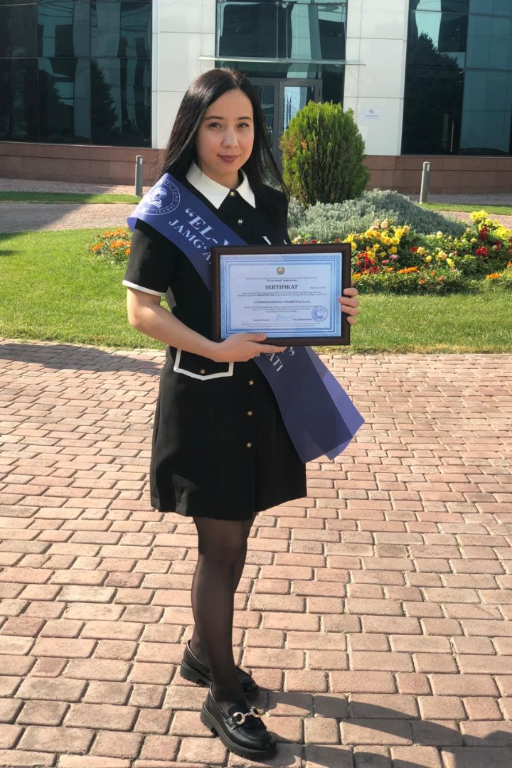
Universe Conspires to Help You
Paulo Coelho’s words inspire belief that when you truly desire something, forces align in your favor.
My Breakthrough
Won the competitive EYUF scholarship to study at University of Bristol, ranked #54 globally.
This achievement marked a turning point, opening doors for global education and growth.

Slide 6
El-Yurt Umidi Foundation Requirements
Must Have
Acceptance letter from a top 300 university (QS, THE, ARWU rankings)
Application Elements
Properly filled application form, entrance test, and interview session
Evaluation
Comprehensive assessment of academic potential and motivation, patriotism.

Slide 7
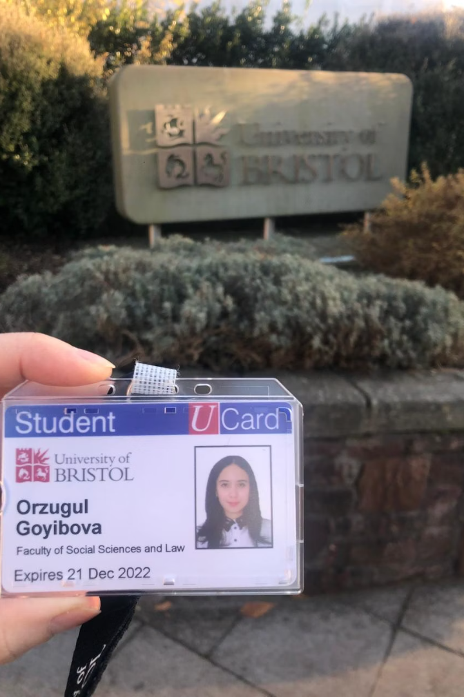
My Academic Journey to the UK
Embraced critical and creative thinking via deep research
Engaged in flipped learning methods promoting active participation
Accessed 24/7 library resources to maximize study time
Built friendships with diverse peers worldwide
Got travel opportunities enriching cultural exposure
Grew into a global citizen with broadened perspectives

Slide 8
What Influences Success?
Genetics
Plomin et al.: Genetics can explain up to 60% of academic achievement (twin study, 2010).
But genes aren't destiny - environment matters too.
Environment
Turkheimer et al.: In low-income families, genetic potential is suppressed; in high-income families, it thrives.
Quality education and support systems play a huge role.
Chance & Luck
Alessandro Pluchino et al. (2018): Simulations show that luck often outweighs talent in long-term success.
Opportunity & Choice
Perry Preschool Study: Early interventions in education lead to better life outcomes—proving environment can change the game.f
We can't choose where we're born - but we can choose where we go!

Slide 9
Special Offers for You!
3 Free Vouchers
3 Discount Coupons
Access the Porla freelancing course for essential skills development.
Enjoy 10% off Porla journal subscriptions to stay informed and inspired.

