Slide 1
IELTS WRITING TASK 1 LESSON

Slide 2
How many task-1 types are there?

Slide 3
Task 1 types
Bar chart
Pie chart
Line graph
Table
*Map
*Process

Slide 4
Task 1 types
Comparative Graph
Trend/Change Graph

Slide 5
Task 1 types
3 Major criteria:
Number of years
Unit of measurement
Number of categories

Slide 6
Number of Years
1 year
2 years
3 years
4+ years (period)

Slide 7
Unit of measurement
Numbers
Percentages

Slide 8
Number of categories
1 category
2 categories
3-6 categories
7+ categories

Slide 9
Let’s see some examples

Slide 10
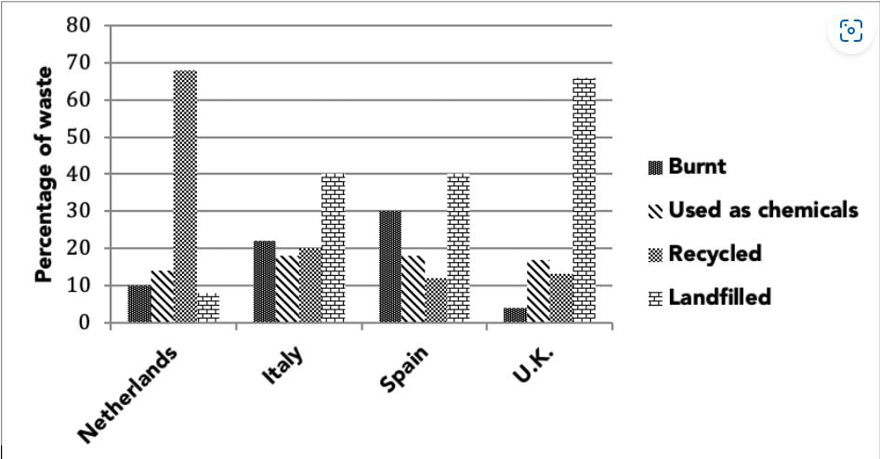
Example

Slide 11
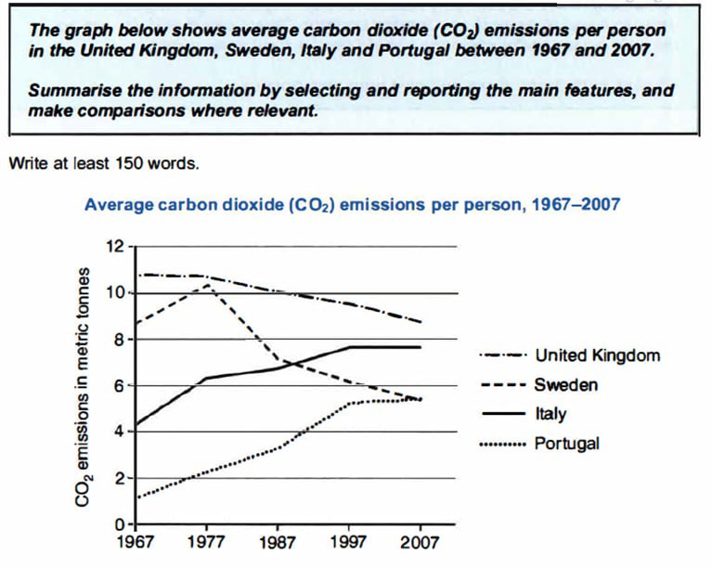
Example

Slide 12
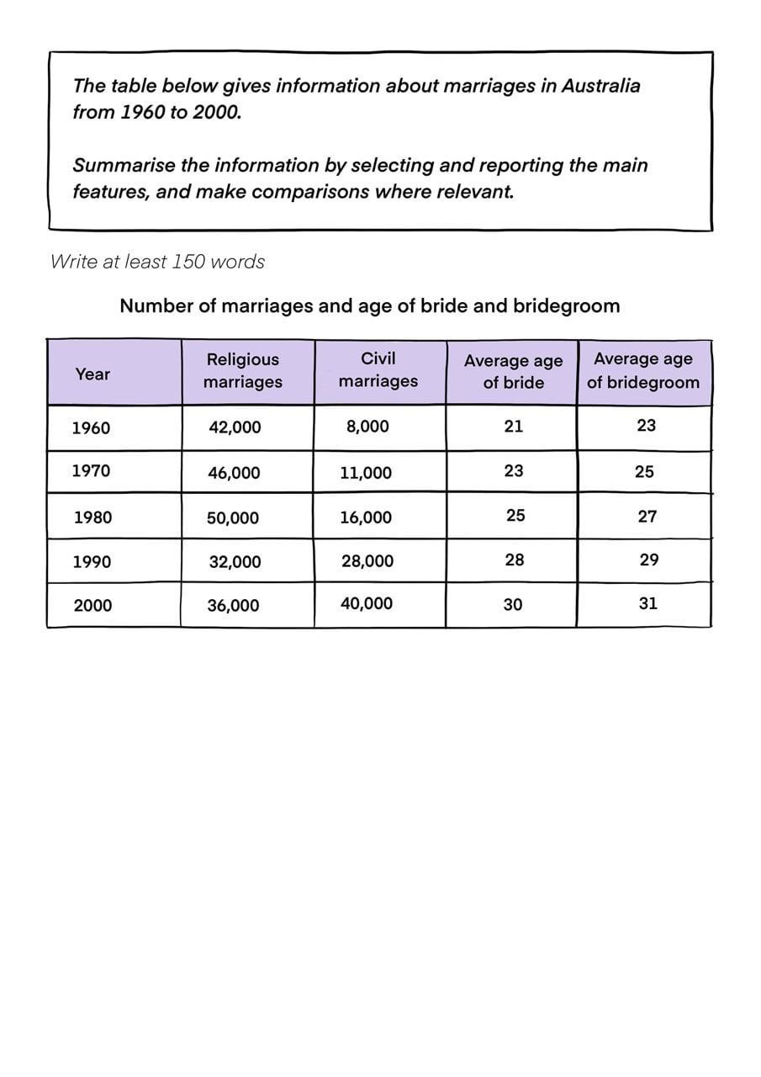
Example

Slide 13
Example

Slide 14
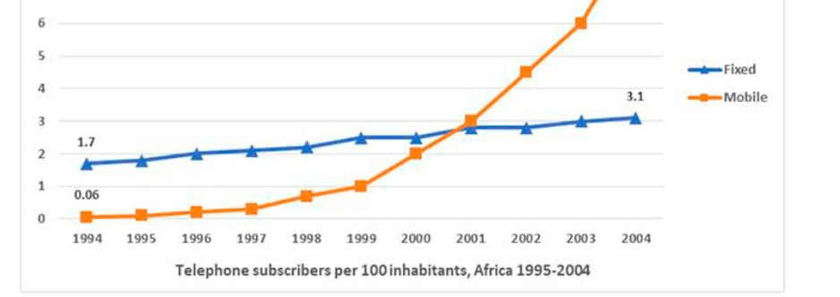
Example

Slide 15
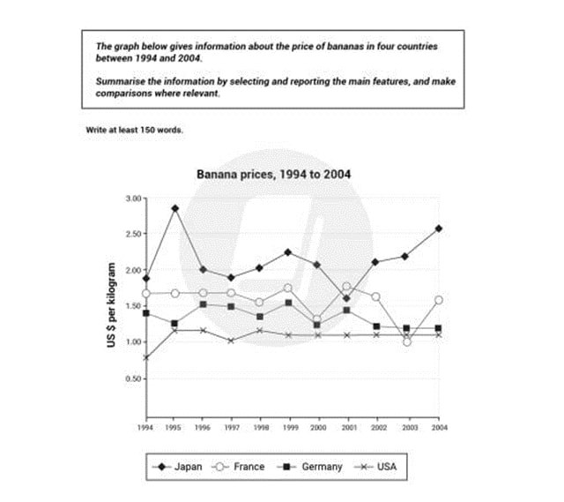
Example

Slide 16
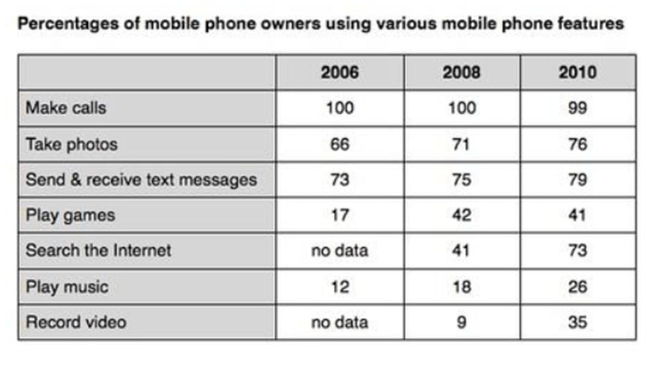
Example

Slide 17
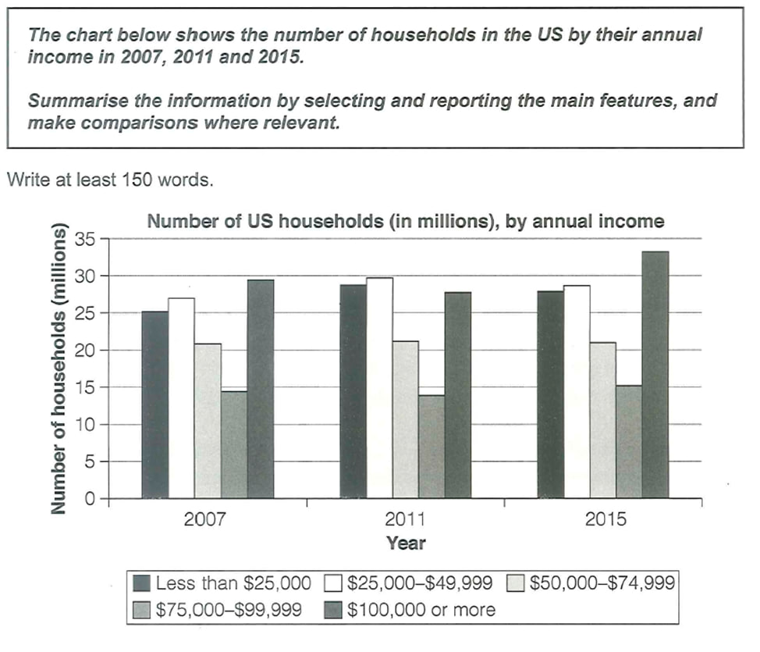
Example

Slide 18
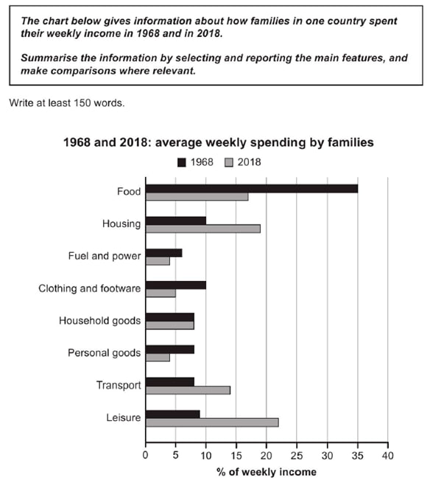
Example

Slide 19
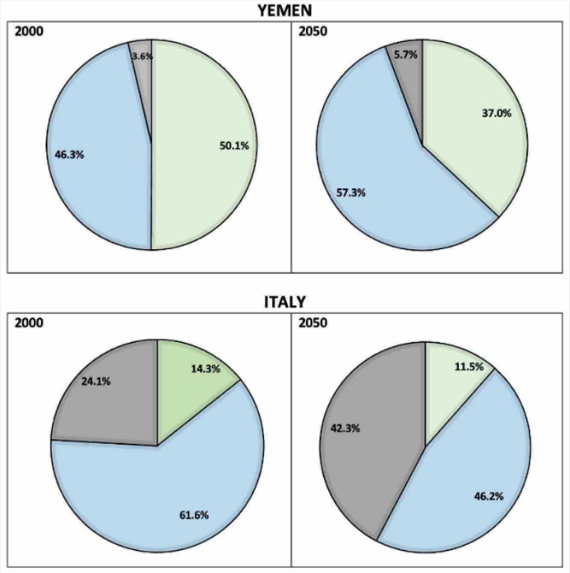
Example

Slide 20
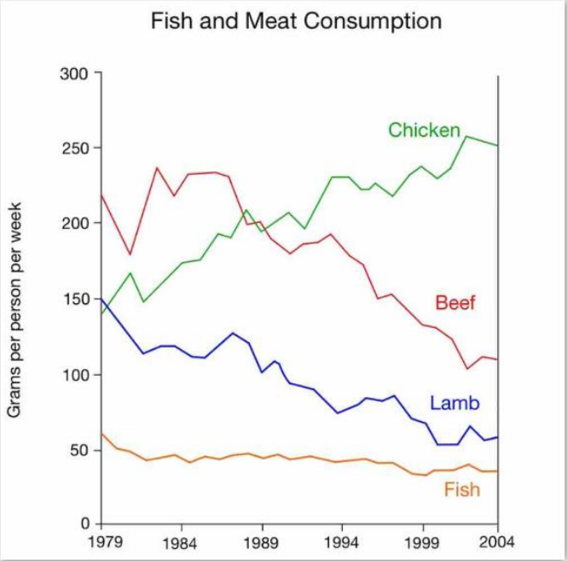
Example

Slide 21
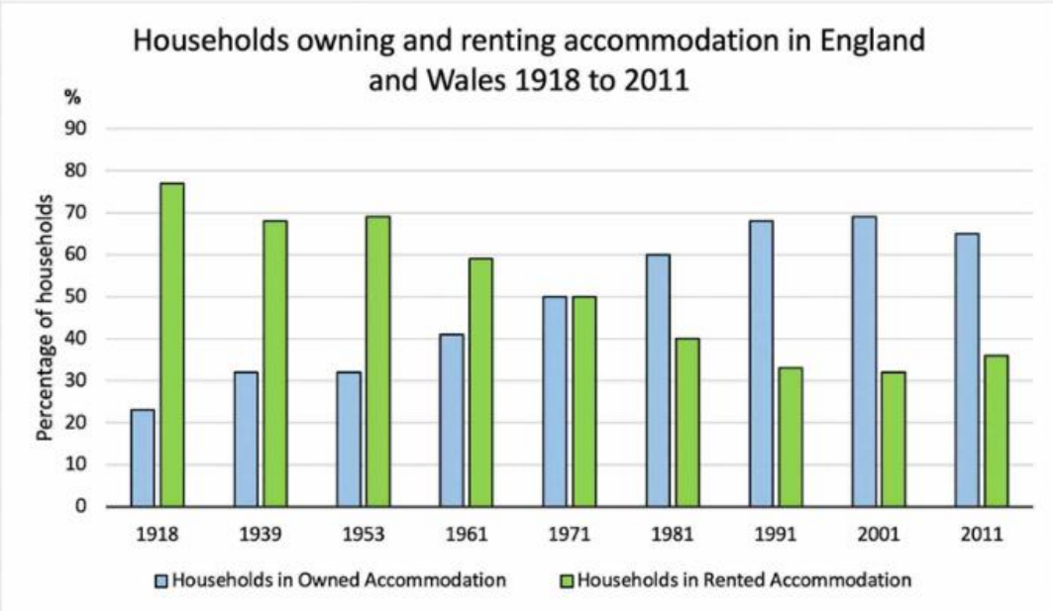
Example

Slide 22
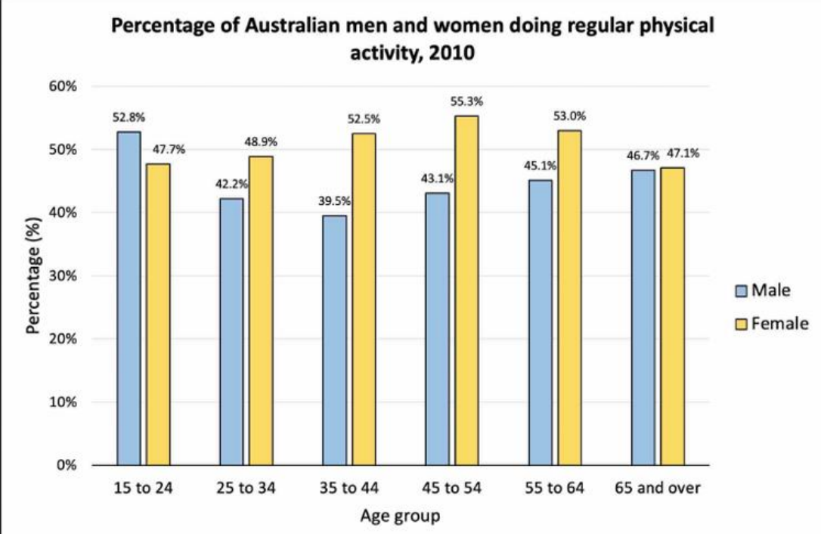
Example

