Slide 2
A.R. Moradi
"Professor of Clinical Psychology and Neuropsychology.“
"Member of the American Psychological Association (APA), Division 12: Clinical Psychology.“
Kharazmi University- Institute for Cognitive Science Studies

Slide 3
Cognitive Rehabilitation

Slide 4
1. Understanding Human Cognition:
Developing comprehensive models of how the mind works.
Example: Understanding how humans learn languages or solve problems.
2. Improving Artificial Intelligence:
Using insights from human cognition to create intelligent systems that mimic or complement human thought processes.
3. Enhancing Education and Learning:
Applying cognitive principles to design better teaching methods and learning environments.
4. Improving Mental Health:
Using cognitive science to diagnose and treat mental disorders like depression, anxiety, and PTSD.
5. Understanding Social Behavior:
Investigating how individuals interact and communicate in groups or societies.
Goals of Cognitive Science
Notes:
به نظر می رسد دستور ناپلئون بخاطر این بود که گال وی را تحت فرنولوژی قرار داده بود و گفته بود که مغز او ویژگی های خاصی ندارد و به این دلیل موجب آزردگی او شده بود. بعد از فلورانس مجددا کسانی مثل بروکا و ورنیکه نظریه لوکالیزیشن را تحکم بخشیدند.

Slide 5
Experimental Psychology:
Controlled experiments to study cognitive processes like memory, attention, or perception.
Neuroimaging:
Techniques like fMRI, EEG, and fNIRS to observe brain activity.
Computational Modeling:
Simulating cognitive processes through algorithms and artificial neural networks.
Behavioral Studies:
Observing how people perform tasks in various contexts.
Linguistic Analysis:
Examining language structure and usage to understand cognitive and communicative processes.
Anthropological and Ethnographic Studies:
Understanding how cognition is shaped by cultural and environmental factors.
Key Methods in Cognitive Science
Notes:
به نظر می رسد دستور ناپلئون بخاطر این بود که گال وی را تحت فرنولوژی قرار داده بود و گفته بود که مغز او ویژگی های خاصی ندارد و به این دلیل موجب آزردگی او شده بود. بعد از فلورانس مجددا کسانی مثل بروکا و ورنیکه نظریه لوکالیزیشن را تحکم بخشیدند.

Slide 6
Education: Designing effective teaching strategies and curricula.
Technology: Enhancing user experience through human-computer interaction (HCI).
Healthcare: Improving diagnostics and therapies for cognitive and neurological disorders.
AI Development: Creating intelligent systems that emulate human thought.
Marketing: Understanding consumer behavior and decision-making.
Applications of Cognitive Science
Notes:
به نظر می رسد دستور ناپلئون بخاطر این بود که گال وی را تحت فرنولوژی قرار داده بود و گفته بود که مغز او ویژگی های خاصی ندارد و به این دلیل موجب آزردگی او شده بود. بعد از فلورانس مجددا کسانی مثل بروکا و ورنیکه نظریه لوکالیزیشن را تحکم بخشیدند.

Slide 7
Diagnosis and Treatment:
Using cognitive models and neuroimaging for early detection of neurological and psychological disorders (e.g., Alzheimer's, PTSD, depression).
Rehabilitation:
Cognitive rehabilitation techniques for stroke or traumatic brain injury patients.
Mental Health:
Designing therapies like cognitive-behavioral therapy (CBT) to address anxiety, depression, and PTSD.
Assistive Technologies:
Developing tools like brain-computer interfaces (BCIs) for individuals with disabilities.
Healthcare and Medicine
Notes:
به نظر می رسد دستور ناپلئون بخاطر این بود که گال وی را تحت فرنولوژی قرار داده بود و گفته بود که مغز او ویژگی های خاصی ندارد و به این دلیل موجب آزردگی او شده بود. بعد از فلورانس مجددا کسانی مثل بروکا و ورنیکه نظریه لوکالیزیشن را تحکم بخشیدند.

Slide 9
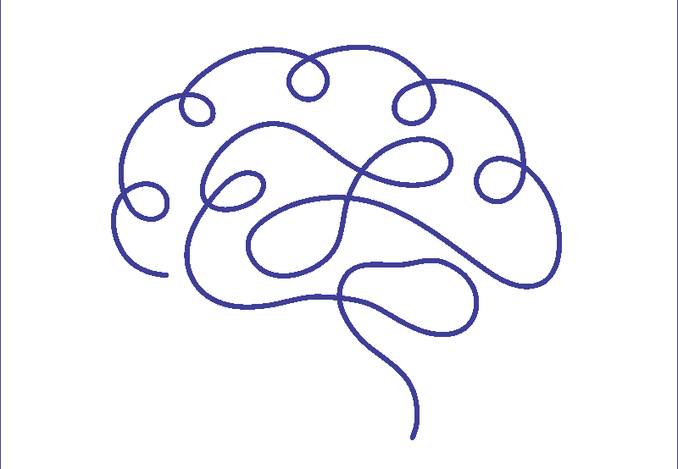
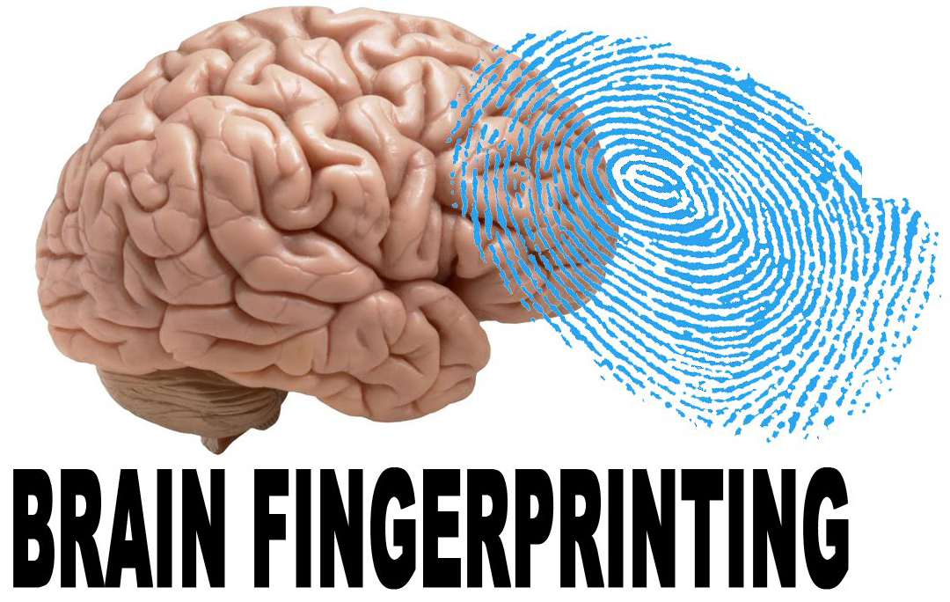
Braincheck.ir
Dr Soroush Lohrasbi | slohrasbi@gmail.com | June 2023 | wesalcenter.com | vesalcenter.com | CBNA in SPORT

Slide 10
User Experience (UX) Design:
Creating intuitive interfaces and software applications that align with human cognitive capabilities.
Voice Assistants:
Improving systems like Siri, Alexa, and Google Assistant for better interaction.
Virtual Reality (VR) and Augmented Reality (AR):
Enhancing immersive experiences for training, education, and entertainment.
Human-Computer Interaction (HCI)
Notes:
به نظر می رسد دستور ناپلئون بخاطر این بود که گال وی را تحت فرنولوژی قرار داده بود و گفته بود که مغز او ویژگی های خاصی ندارد و به این دلیل موجب آزردگی او شده بود. بعد از فلورانس مجددا کسانی مثل بروکا و ورنیکه نظریه لوکالیزیشن را تحکم بخشیدند.

Slide 11
What is cognitive rehabilitation?
Cognitive rehabilitation is a therapeutic approach designed to help individuals regain or improve cognitive functions that have been impaired due to brain injury, illness, or psychological disorders.
This therapy focuses on enhancing skills such as attention, memory, problem-solving, and executive functions to improve daily functioning and quality of life.

Slide 12
There are two primary approaches in cognitive rehabilitation:

Slide 13
Restorative Rehabilitation:
This approach aims to restore lost cognitive functions through repetitive exercises and activities that challenge specific cognitive domains. For example, memory training exercises might involve recalling word lists or engaging in problem-solving games to enhance cognitive skills.

Slide 14
Compensatory Rehabilitation:
When certain cognitive functions cannot be fully restored, compensatory strategies are employed to help individuals work around their deficits. This might include using external aids like calendars, memory tools, or setting alarms to assist with daily tasks and organization.

Slide 15
Virtual Reality (VR) Therapy:
VR provides immersive environments where individuals can practice real-life scenarios in a controlled setting, aiding in the improvement of cognitive functions such as attention and problem-solving. However, it's important to note that some health plans consider VR therapy experimental and investigational for cognitive rehabilitation.

Slide 16
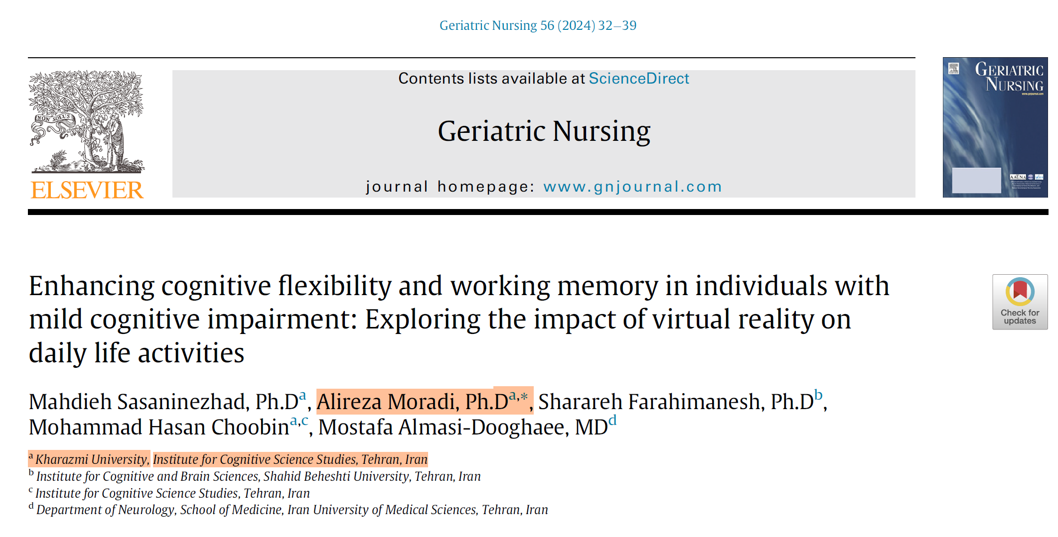

Slide 17
Neurofeedback
Also known as electroencephalogram (EEG) biofeedback, this technique allows individuals to observe their brainwave patterns in real-time and learn to regulate them. This self-regulation can lead to improvements in attention, relaxation, and overall cognitive function.

Slide 18
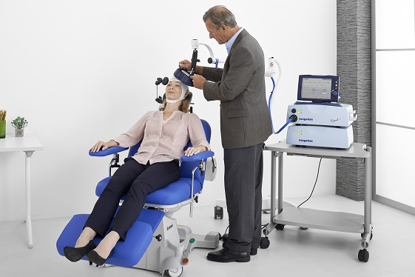
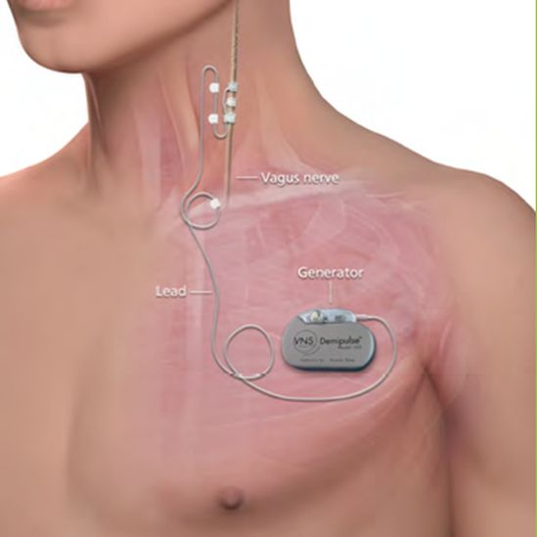
New therapeutic approaches: brain stimulation
Deep brain stimulation
TMS
Vagal nerve stimulation

Slide 19
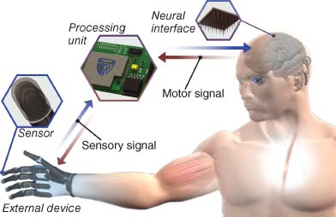
Neural prosthetics (brain-machine interface)

Slide 20
Computer-Assisted Cognitive Training
Utilizing specialized software, individuals engage in exercises tailored to target specific cognitive deficits. These programs often adapt to the user's performance, providing a personalized rehabilitation experience.

Slide 21
Psychotherapies
Cognitive-Behavior Therapy
Acceptance commitment Therapy
Behavioral Activation
Spiritual and Meaning Therapy

Slide 22
Mindfulness and Meditation
Mindfulness and Meditation: Incorporating mindfulness practices and meditation has been shown to improve focus, attention, and emotional regulation, contributing positively to cognitive rehabilitation efforts.

Slide 23
سپاس بیکران از شکیبایی شما
هین سخن تازه بگو تا دو جهان تازه شود
وارهد از حد جهان بی حد و اندازه شود
حضرت مولانا

Slide 24
سپاس بیکران از شکیبایی شما

